Slide 1

Student Ambassador Projects
Notes:
Korrie

Slide 2
SystemX64 Solution Type: Video
Mohammad Anzil Parveez
Zeliq Zayyan
Darshan Bhandary
Notes:
Korrie

Slide 3
Revolutionizing Assistive Technology for the Visually Impaired
Talk from the customers’ perspective about industry trends and pain points and opportunities.
Customer Perspective:
Growing need for assistive solutions to address mobility, safety, and affordability challenges.
Opportunity to empower independence through innovation.
Disruptive Approach:
Scalable, AI-powered wearable device targeting an underserved market.
Solves unnoticed problems, challenging the status quo.
Empathy & Inspiration:
Designed with empathy for daily struggles.
Inspires stakeholders by showcasing transformative potential for safety and independence.
Why Companies Should Care:
Combines AI and IoT for real-time navigation, delivering fast value.
Positions companies as leaders in inclusive innovation.
Creates a profound societal impact by enhancing accessibility.
Notes:
Korrie
updated 7/21

Slide 4
Solution
Share why you built this solution and where you fit in.
Smart Vision Assistant:
Camera captures and describes surroundings in natural language
"There's a coffee table with chairs, and a person walking nearby"
"A doorway ahead with stairs to the right“
Intuitive Feedback System:
AI processes images into detailed scene descriptions
Vibration motor intensity adapts to obstacle proximity
Distance-based haptic feedback (stronger vibration = closer object)
Natural voice narrates the environment continuously
Why It Matters:
More descriptive than traditional aids
Combines AI vision with intuitive haptic guidance
Affordable solution for daily navigation
Addressing Pain Points:
Affordable (70% cheaper than competitors) and hands-free.
Real-time AI-powered navigation with voice and haptic feedback.
Notes:
Korrie
updated 7/21

Slide 5
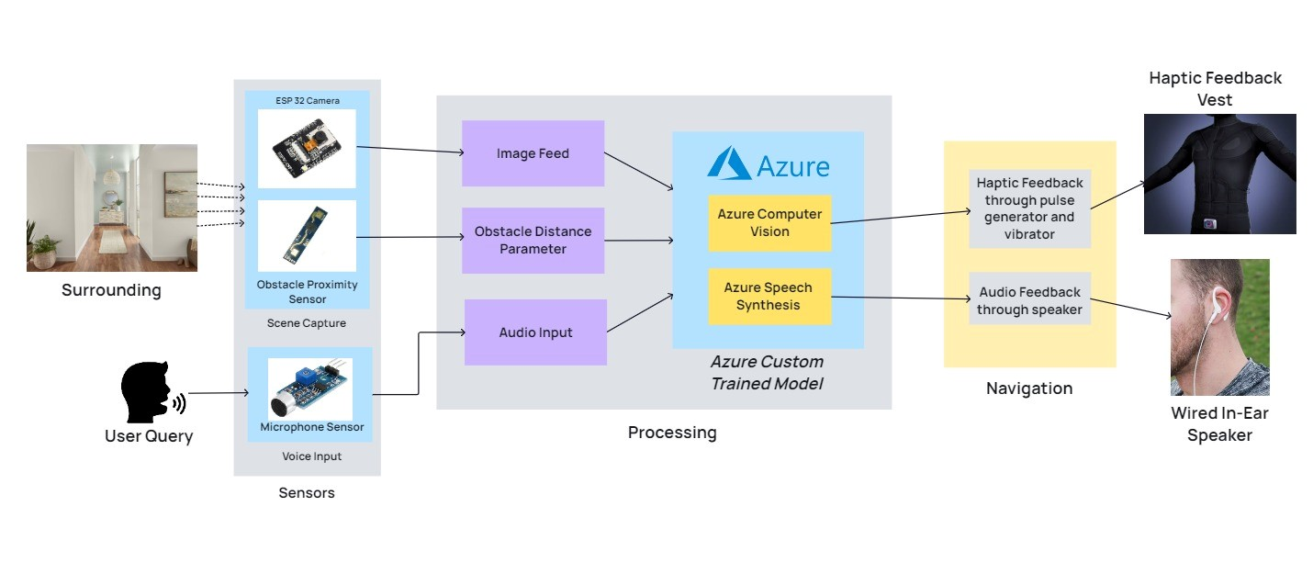
Architecture
Notes:
Korrie
updated 7/21

Slide 6
Takeaways
Stop Doing:
Relying on outdated, passive aids like white canes or expensive, inaccessible solutions.
Ignoring the potential of affordable, AI-driven assistive technology.
Start Doing:
Embracing innovative, real-time navigation solutions for visually impaired individuals.
Partnering with startups to drive inclusive, scalable technology.
What Can Be Done Without Us:
Incremental improvements to existing aids, but limited by cost and functionality.
How We Simplify the Process:
Our solution combines AI vision, natural language descriptions, and haptic feedback to provide a seamless, intuitive experience.
It’s 70% cheaper than competitors, making it accessible to a broader audience.
Notes:
Korrie
updated 7/21

